Slide 1

Modeling uncertainty: concepts and philosophies
Modeling Uncertainty in the Earth Sciences
Jef Caers
Stanford University

Slide 2
Quote
“Imagination is more important than knowledge: for knowledge is limited to what we know and understand while imagination embraces the entire world and all that ever will be known and understood”
Albert Einstein

Slide 3
Why is there uncertainty?
Uncertainty is caused by an incomplete understanding about what we like to quantify
We roughly know (measurement error)
We could have known (non-exhaustive sampling)
We don’t know what we know (interpretation)
We don’t know what we don’t know (limited imagination)
We cannot know (can never be measured)

Slide 4
Deterministic modeling
Deterministic model: a single (or few) Earth model that includes most accurately all physical and spatial relationships at the finest detail computationally possible

Slide 5
Limitations of deterministic models
More physics does not mean more accuracy
Uncertainty in physics
Uncertainty in calibration of parameters etc…
A single model is for certain not equal to the truth
They can be a useful start, but have no prediction power
Most of what is currently done is deterministic modeling

Slide 6
Models of uncertainty
uncertain
uncertain
certain or uncertain
uncertain
Spatial
Input parameters
Spatial
Stochastic
model
Physical model
Forecast and decision model
response
uncertain
Physical
input parameters
Datasets
uncertain
Raw
observations
uncertain/error

Slide 7
Model and data relationship
Why can’t we make a decision from the data itself?
What is “data”? Let’s distinguish:
Raw measurements or observations
Data sets
Information and knowledge
Aim toward a symbiosis:
Data requires a “model” to be interpreted and models require data to be predictive
Data-driven models and model-dependent datasets

Slide 8
A mathematical framework
Bayes’ rule: a internally consistent framework for scientific-based uncertainty modeling
a₁, a₂, a₃, … , a_{L} = a model of uncertainty

Slide 9
Result
E₁ = “the deposit is profitable”
F₁ = “the garnet content exceeds 6.5ppm”
Prior probability: determined by considering all diamond deposits around the world, without considering any data that reveals anything specific about that deposit
Likelihood probability: the uncertain relationship between a specific outcome of the prior and the data
Posterior probability: the remaining uncertainty when considering the data

Slide 10
What does Bayes’ rule suggest?
A mental exercise should be made at collecting all possibilities imaginable prior to including the data into the model
The data can only falsify outcomes of the prior
Putting too much focus immediately on data is extremely tempting and may lead to an artificial reduction of uncertainty and unpleasant surprises
There is no escape in specifying a prior ! Each such specification is subjective.

Slide 11
Exclude or Include ?
Modeling uncertainty by inclusion (accepting)
Include all those possibilities that can be explained by the observed data, accounting for the uncertain relationship between data and outcomes
Modeling uncertainty by exclusion (rejecting)
Collect all possibilities prior to looking at data, then exclude those possibilities that can be rejected from the data
Exclusion is more conservative than inclusion and often preferred given the psychology of expert collaboration

Slide 12
Model verification and falsification
Can we check whether a model of uncertainty is correct ?
Can we check whether a deterministic model is correct ?
How to verify any model ?

Slide 13
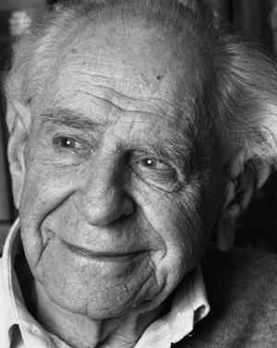
Karl Popper
physical processes are laws that are only abstract in nature and can never be proven correct, they can only be disproven (falsified) with facts or data
the term falsifiable should not be mistaken for “being false”: it means that if a scientific theory is false, then this can be shown by data or observations
No model can be proven correct: all models are subjective and limited to human imagination

Slide 14
Model complexity
Occam’s razor principle
“entities must not be multiplied beyond necessity”
translation: “when competing models are equal in various respects, select the model that introduces the fewest parameters/variables and simpler physics”
It does not mean that simpler models should be taken over complex models
dependency on the decision question needs to be addressed
Model complexity should always be one of the modeling parameters in models of uncertainty

Slide 15
“Talking” about uncertainty
YES
quantifying uncertainty
assessing uncertainty
modeling uncertainty
realistic assessment of uncertainty
NO
estimating uncertainty
best uncertainty estimate
optimal uncertainty
correct uncertainty

Slide 16
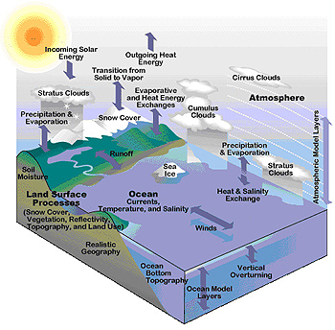
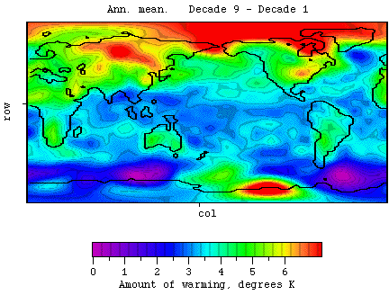
Example: climate modeling

Slide 17
Modeling challenges
Deterministic modeling: most current models aim at including more physics, not on modeling uncertainty
Data sets: quality varies, data such as from satellite requires processing/interpretation (models)
Sub-grid uncertainty: important fine-scale variation (clouds) have global impact
Model complexity: should depend on what is to be done with those models
Predict mean temperature increase
Predict CO2 increase
Regional climate change forecast

Slide 18
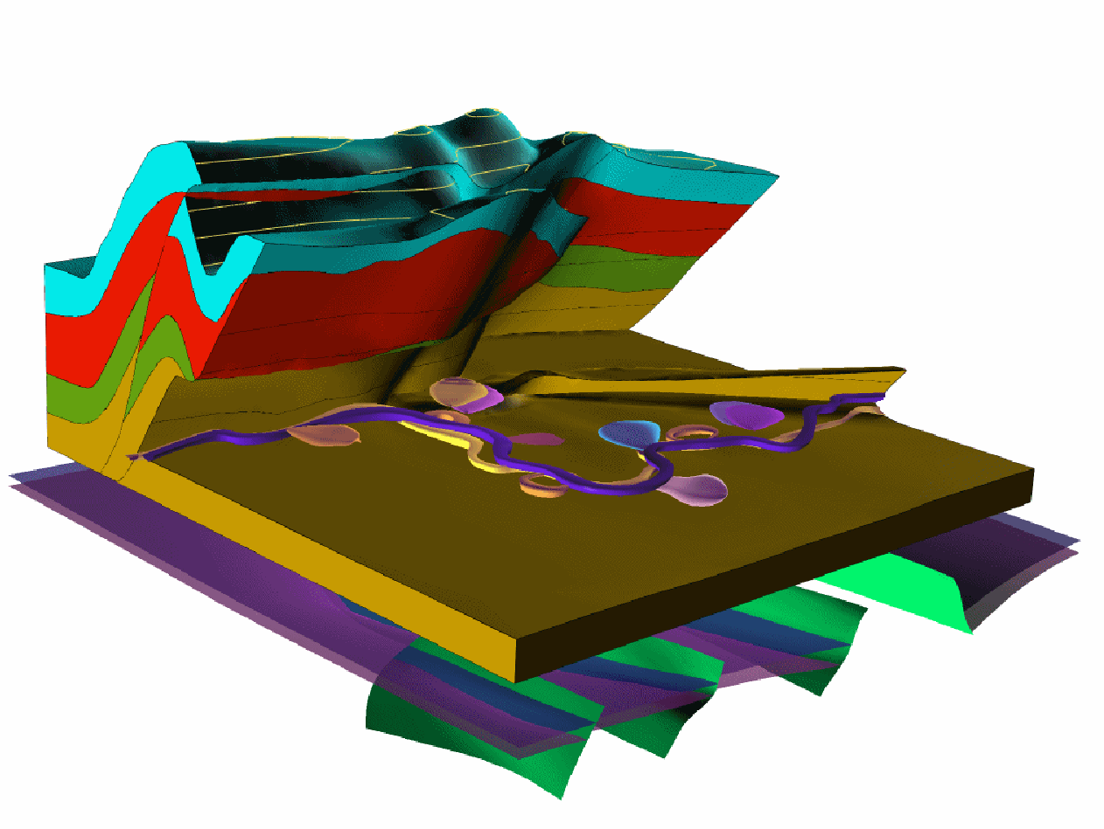
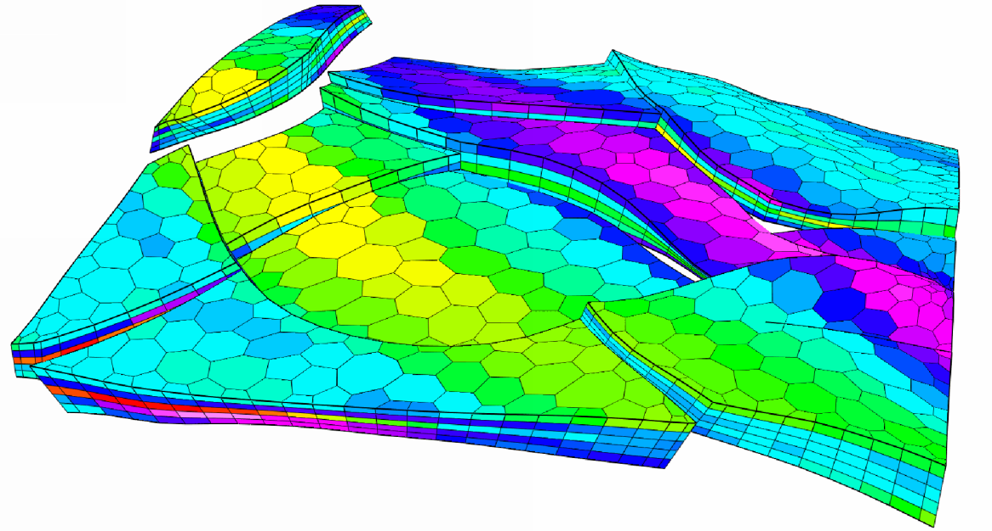
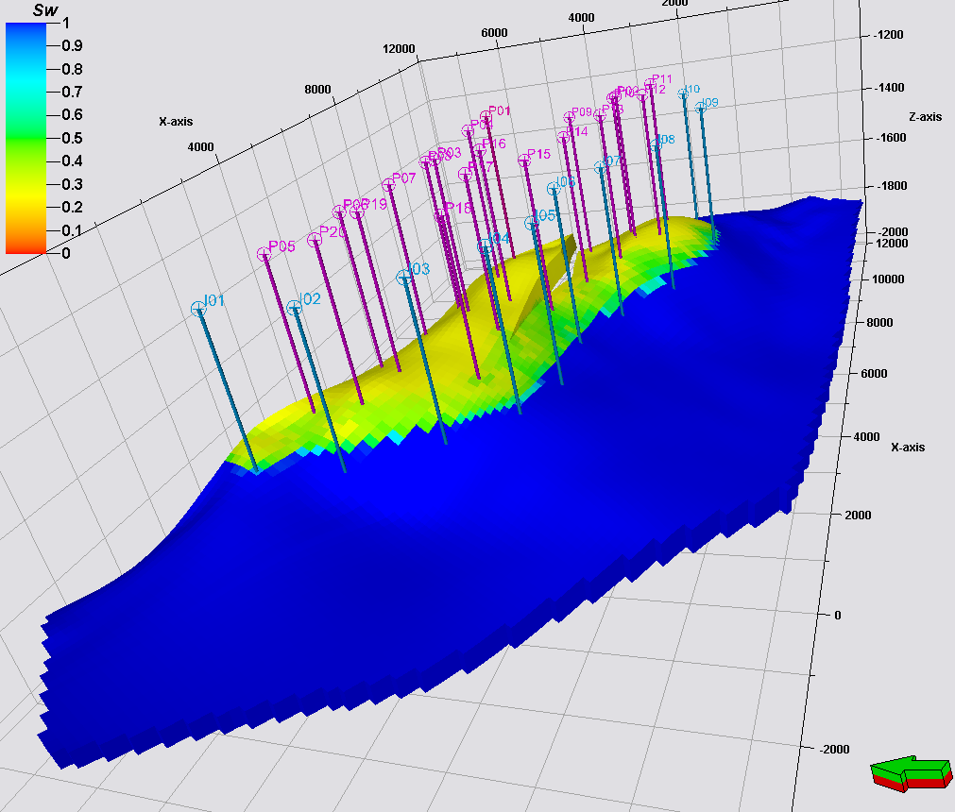
Example: reservoir modeling

Slide 19
Modeling challenge
Large variety of data to build such models, each requiring considerable “domain expertise”
Real variability is very small-scale and cannot be represented using the grid cell sizes of current models
What constitutes a good model ?
A model that represents the data accurately ?
A model that leads to making good decisions ?
In both examples: computational challenges !

Slide 20
Spatial
Stochastic
model

Slide 21
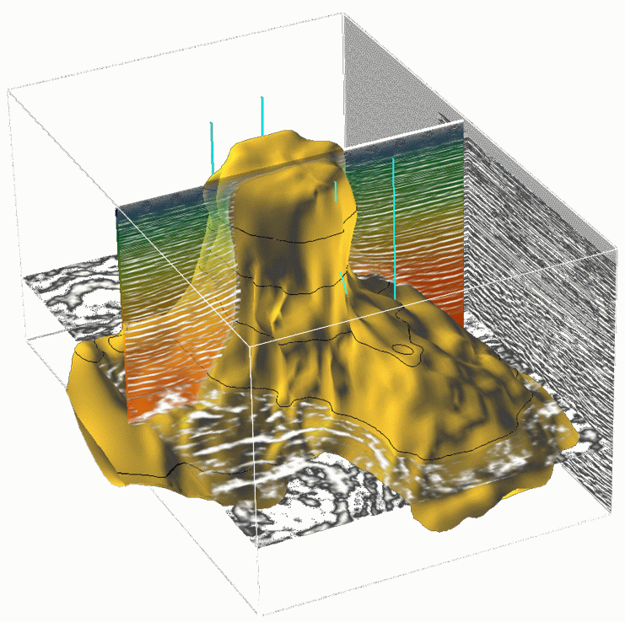
Datasets

Slide 22
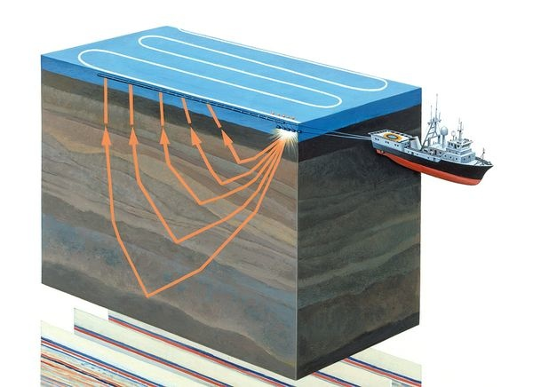
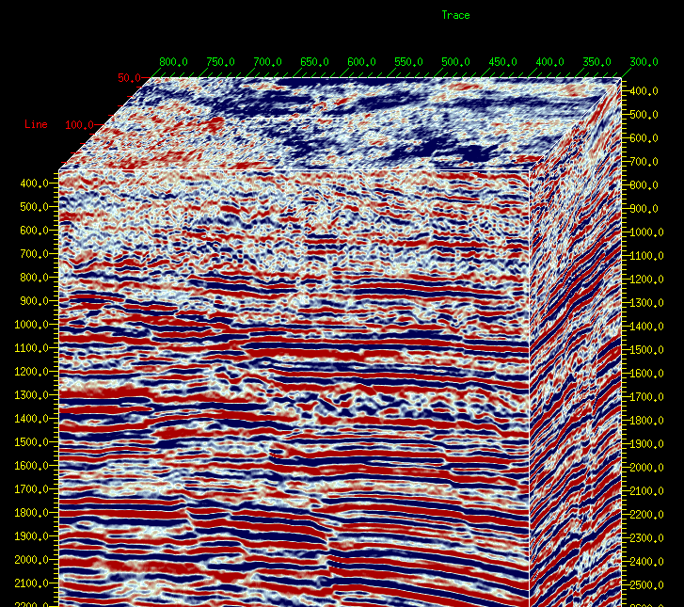
Raw
observations

Slide 23
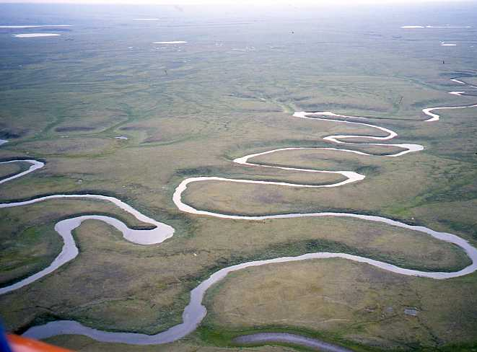
Spatial
Input parameters

Slide 24
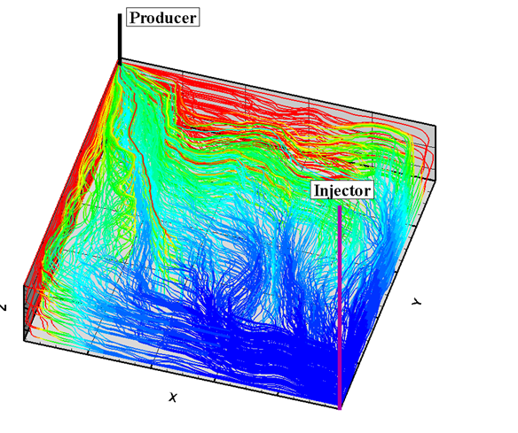

Climate models
Physical model
Physical
input parameters
Subsurface flow
Flow in porous media

Slide 25
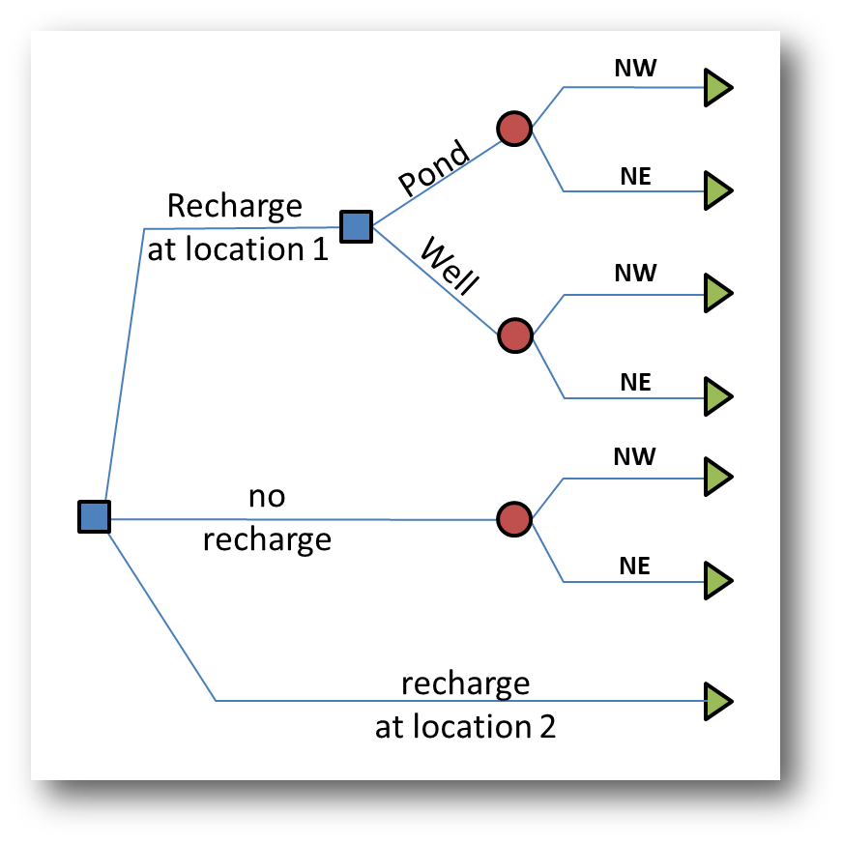
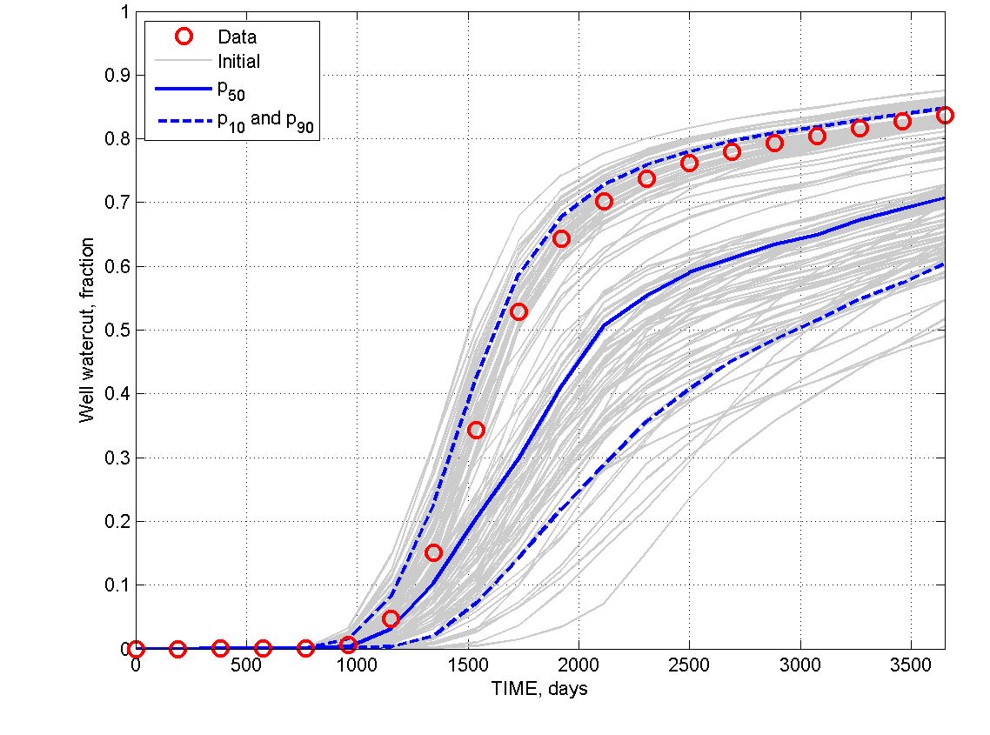
Forecast and decision model
Decision model
Forecast

